Slide 1
RI-INBRE Bioinformatics Core Summer Workshop Series
Introduction to R:
Data Types and Data Structures
June 8, 2016

Slide 2

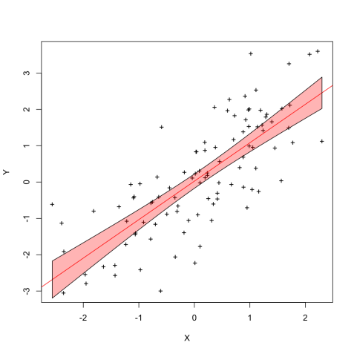
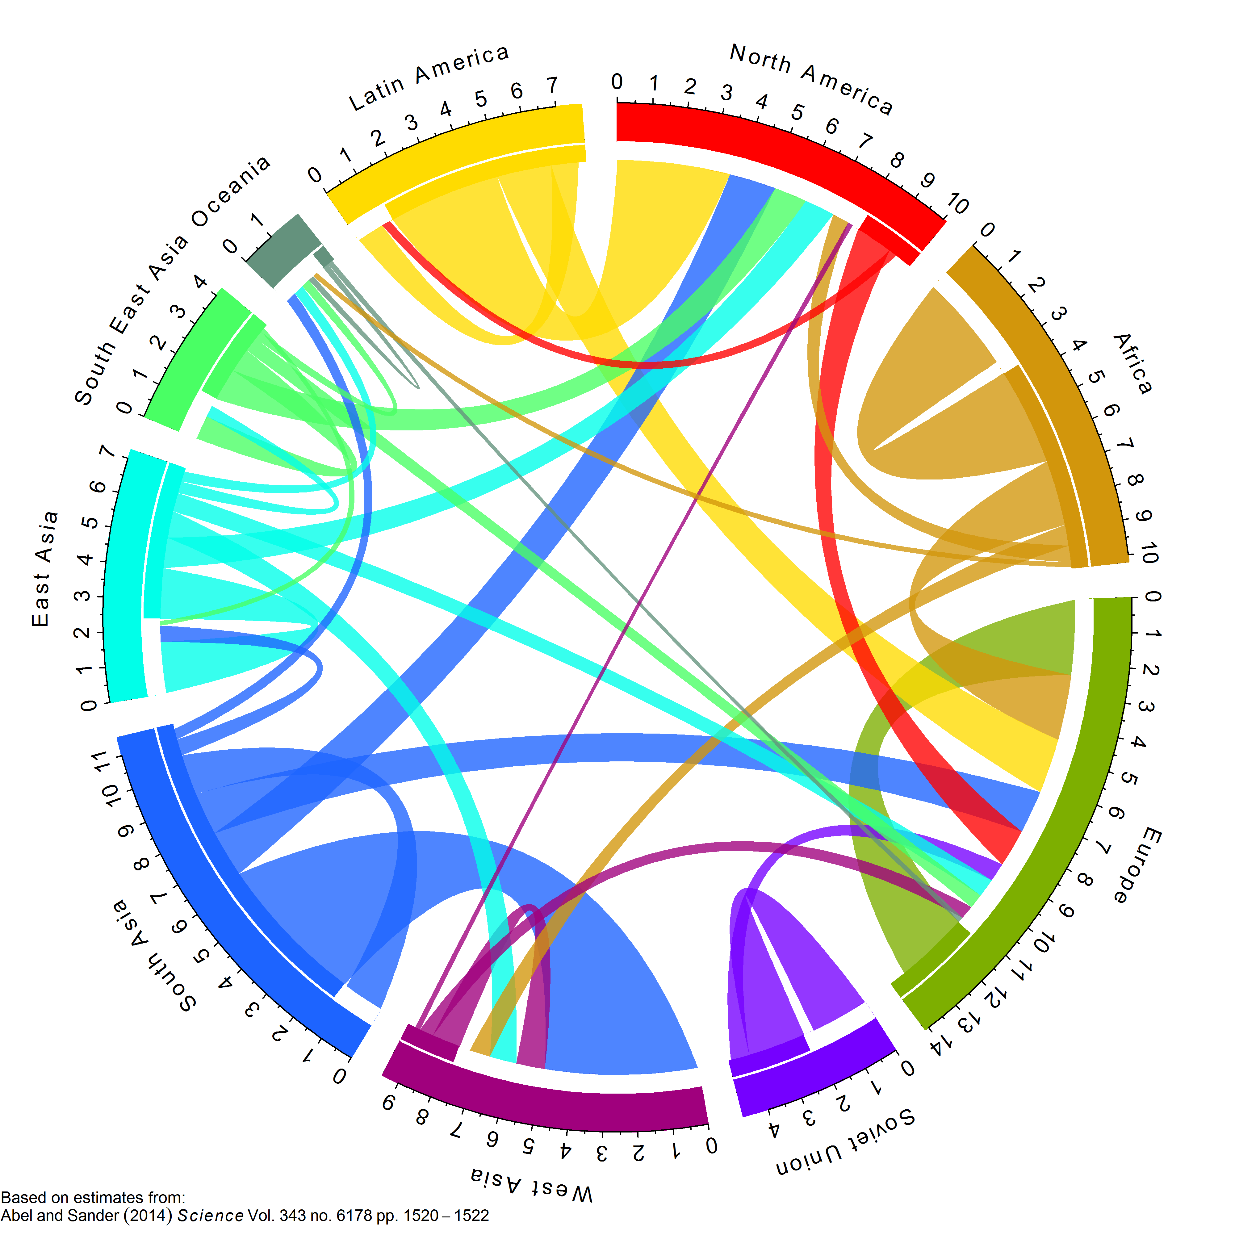
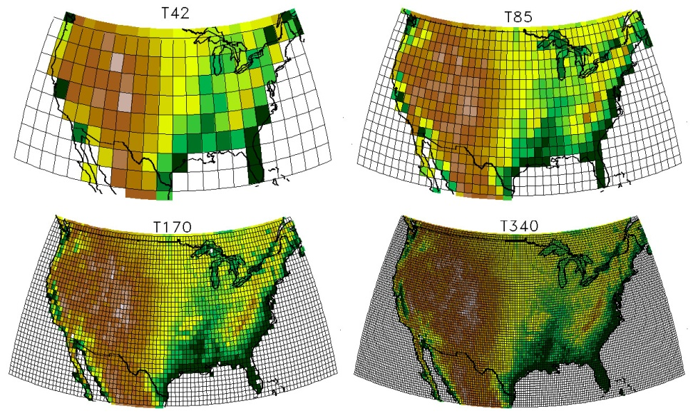
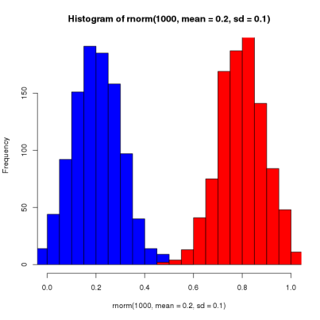
Why Use R?
It’s free! (as in open source)
It’s free! (as in it costs nothing)
It’s supported by the community
It’s designed for statistics and data visualization

Slide 3
Getting Help in R
?<function name>
??<search>
vignette()

Slide 4
Getting Help in R
?<function name>
??<search term>
vignette()

Slide 5
R Data Types
Data types – The “kind” of data
Numeric (a floating point number, e.g. 3.141)
Integer (a whole number, e.g. 1)
Character (alphanumeric string, e.g. “Biology”)
Boolean (logical value, e.g. TRUE)
Special Characters (e.g. NA, NaN, Inf, -Inf)

Slide 6
R Data Types
What data types describe the following?
1
1L
“1”
TRUE
T

Slide 7
How Do We Know Our Data Types?
is/as functions
is (conditional)
as(conversion)
 | is | as
Numeric | is.numeric | as.numeric
Integer | is.integer | as.integer
Character | is.character | as.character
Boolean | is.logical | as.logical
Inf | is.finite is.infinite | -
NA | is.na | -
NaN | is.nan | -

Slide 8
R Data Types
What data types describe the following?
1
1L
“1”
TRUE
“TRUE”
T
Numeric
Integer
Character
Boolean
Character
Boolean
R coerces data into the type it thinks it should be!

Slide 9
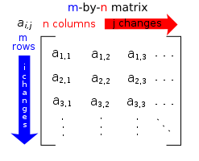
Data Structures in R
Data Structures have:
Dimensionality
Homogeneity
Dimensionality | Homogeneous | Heterogeneous
One-Dimensional | Vector | List
Two-Dimensional | Matrix | Data Frame
Multi-Dimensional | Array | -
 | is | as
Vector | is.vector | as.vector
Matrix | is.matrix | as.matrix
Array | is.array | as.array
List | is.list | as.list
Data Frame | is.data.frame | as.data.frame

Slide 10
Creating Data Structures in R

